Slide 1


















Raising Awareness on Environmental Issues through Visual Content
CHAPTER 6

Slide 2






INTRODUCTION
How visual communication can raise awareness about environmental issues?
Effective visual messages can influence sustainable behavior and guide the development of impactful policies.

Slide 3

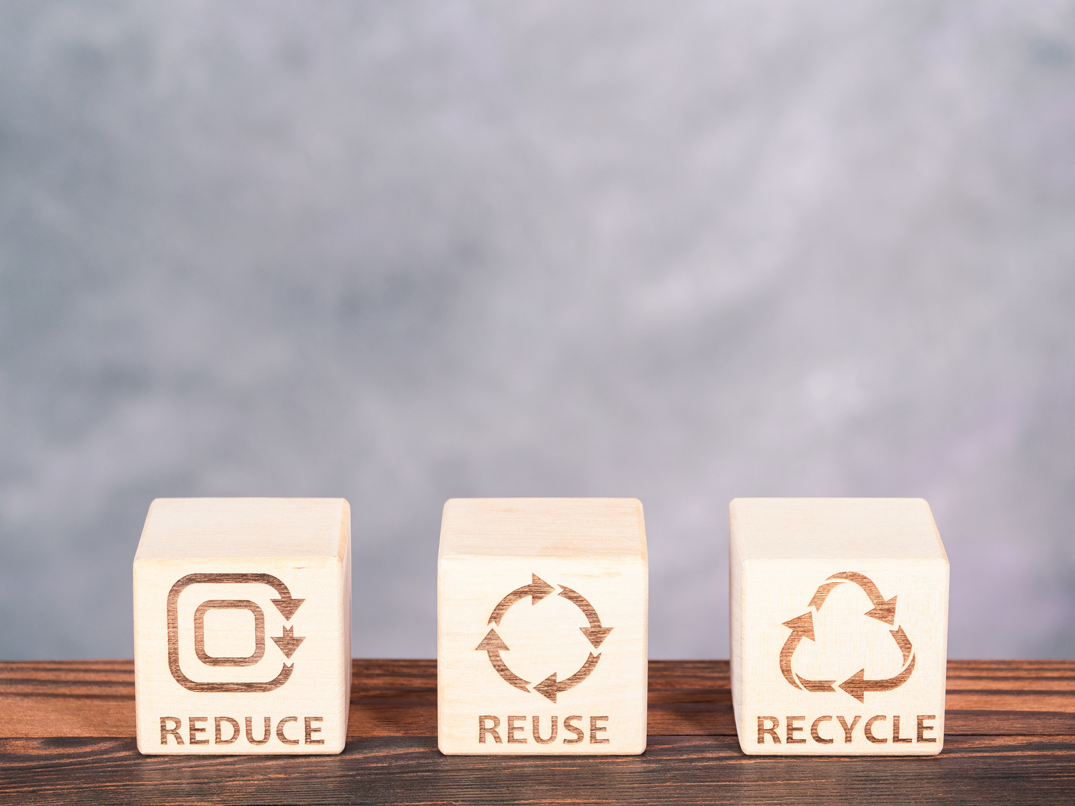

The Importance of Environmental Awareness
recycling, renewable energy, and resource conservation
Environmental awareness is essential for influencing sustainable behavior and developing effective policies. Education and information play a crucial role in promoting environmentally friendly practices and motivating individuals and communities to adopt sustainable behaviors.

Slide 4



The European Green Deal
The European Union's European Green Deal aims to transform Europe into a climate-neutral continent by 2050. This policy includes strategies to promote the circular economy, reduce greenhouse gas emissions, increase the use of green energy, and improve biodiversity.

Slide 5




Educating the Public
benefits of public education on environmental policies
Educating the public about environmental policies increases transparency, democratic participation, and popular support for sustainability initiatives. A well-informed society is better equipped to support and implement decisions that protect the environment for future generations.

Slide 6



The Role of Visual Media
impactful environmental images
Effective visual messages can transform abstract concepts like climate change into relatable and urgent issues, motivating individuals and communities to adopt sustainable practices.
They also play a key role in educating the public, influencing behavior, and shaping policy by making data and statistics accessible and engaging.
Ultimately, effective visual messages are not just about aesthetics; they are strategic tools that drive awareness, inspire action, and facilitate meaningful change.

Slide 7

Effective Visual Messages
Sea Shepherd's Campaign Against Plastic Pollution
Sea Shepherd's Campaign Against Plastic Pollution uses bold posters and videos showing marine wildlife trapped in plastic waste, with direct messages to prompt immediate action.

Slide 8





Social Impact of Visual Messages
impact of visual messages on public behavior
Visual messages have a powerful impact on public behavior and environmental policies. They serve as catalysts for awareness and change, making environmental problems tangible and motivating sustainable practices.

Slide 9





Transforming Environmental Ethics
  environmental practices and policies
Visual messages not only inform but also transform environmental ethics and practices. They play a crucial role in shaping a deeper and more active environmental awareness, influencing both individuals and policy decisions.

Slide 10






Conclusion
Effective visual communication is essential for raising environmental awareness and promoting sustainable behavior. By leveraging the emotional and persuasive power of images, we can drive significant social and environmental change.

Slide 11
Thank you very much

