Slide 1


















Key Messages and Images to Overcome Prejudices and Stereotypes
CHAPTER 5

Slide 2







INTRODUCTION
Key messages and images can help overcome prejudices and stereotypes.
Visual media has a profound emotional and persuasive power that transcends cultural and linguistic barriers, influencing our perceptions and emotions deeply.

Slide 3

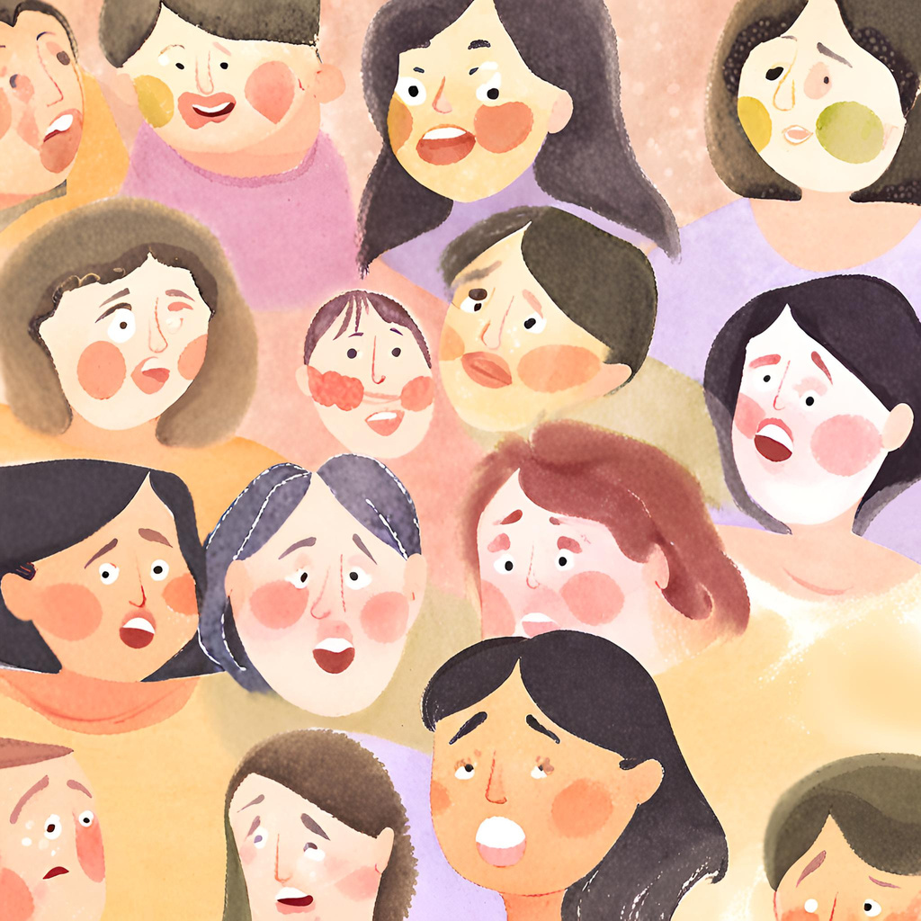

The Power of Images
Images possess a profound ability to influence perception and evoke emotions, making them effective tools for overcoming cultural and linguistic barriers. They can stimulate empathy and understanding among different social groups.

Slide 4



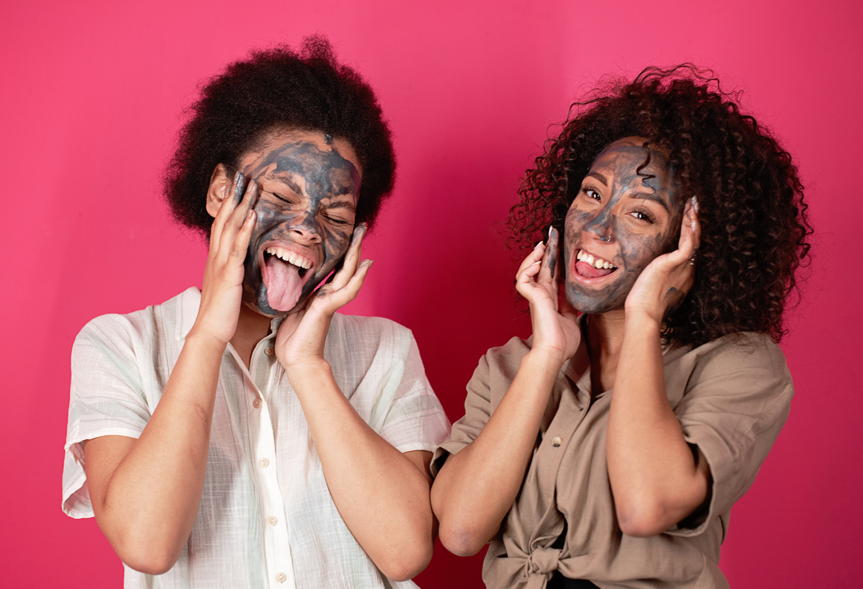



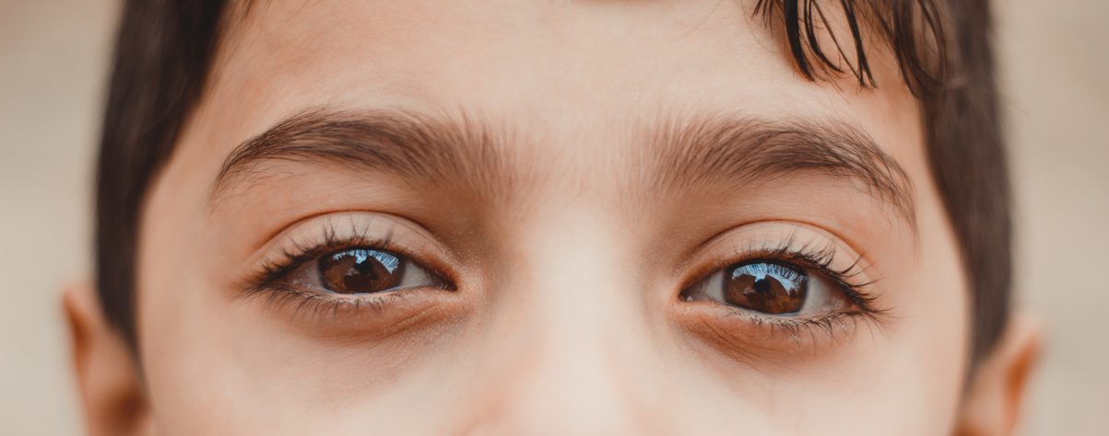

Techniques to Increase Empathy
  Human Portraiture: Allows viewers to connect with individuals and feel their emotions.
  Universal Facial Expressions: Joy, sorrow, etc., evoke immediate empathetic responses.
  Visual Storytelling: Photographic sequences and storyboards illustrate shared challenges and experiences.

Slide 5


Enhancing Emotional Messages
use of color and composition
1. Colors, Lights, and Composition: Intensify the emotional message and underline themes of universality and contrast.
2. Visual Language: Acts as a cultural bridge, stimulating empathy and encouraging dialogue and understanding.

Slide 6


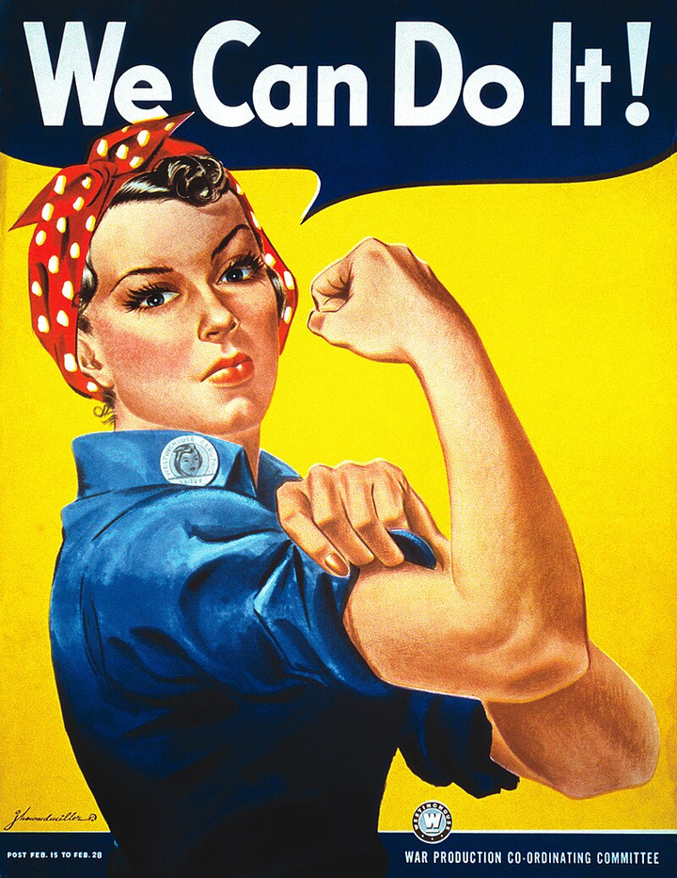


Social Change through Visual Media
Historical and contemporary campaign images
Images can move consciences and direct the narrative towards broader inclusion, acting as powerful tools for social change.
"We Can Do It" (1943): Icon of feminism and female empowerment

Slide 7

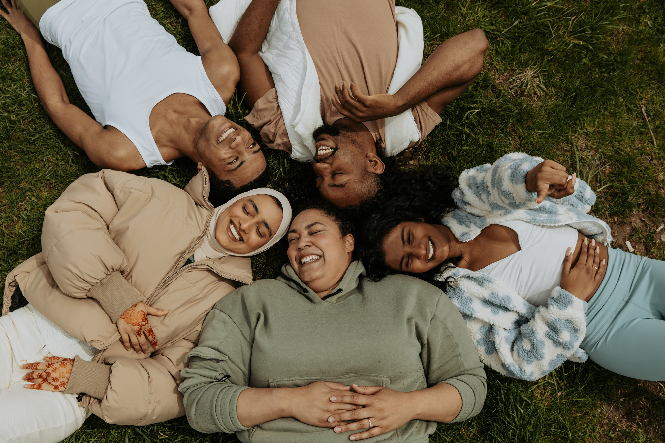

Creating Inclusive Visual Messages
01.
Image Selection
Choose images that authentically represent different communities
02.
Text and Visual Elements
Combine effectively to amplify the message of inclusion
03.
Use of Color and Composition
Guide the viewer's eye and evoke desired emotions

Slide 8





Authentic and Respectful Representations
images showing diversity
  Avoid Stereotypes: Show the richness and variety of human experiences.
  Truthfulness: The chosen images and tone of text influence perception and promote acceptance and understanding.

Slide 9

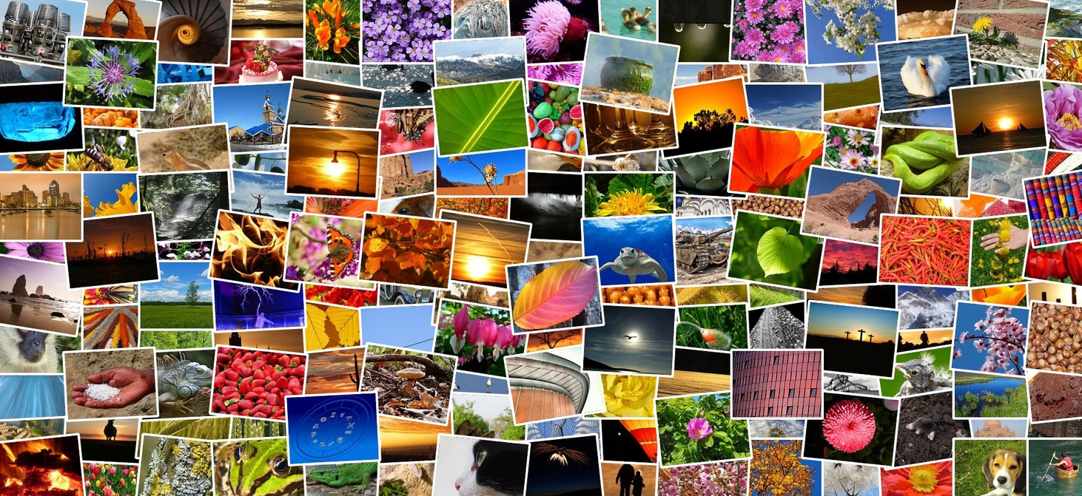

Conclusion
A well-designed visual message not only captures attention but can also educate and contribute to positive cultural change towards greater equity and inclusion. Using visual media thoughtfully can promote empathy, understanding, and social cohesion

Slide 10
Thank you very much

