Slide 1


















Impact of New Visual Communications on Cognitive Processes
CHAPTER 4

Slide 2


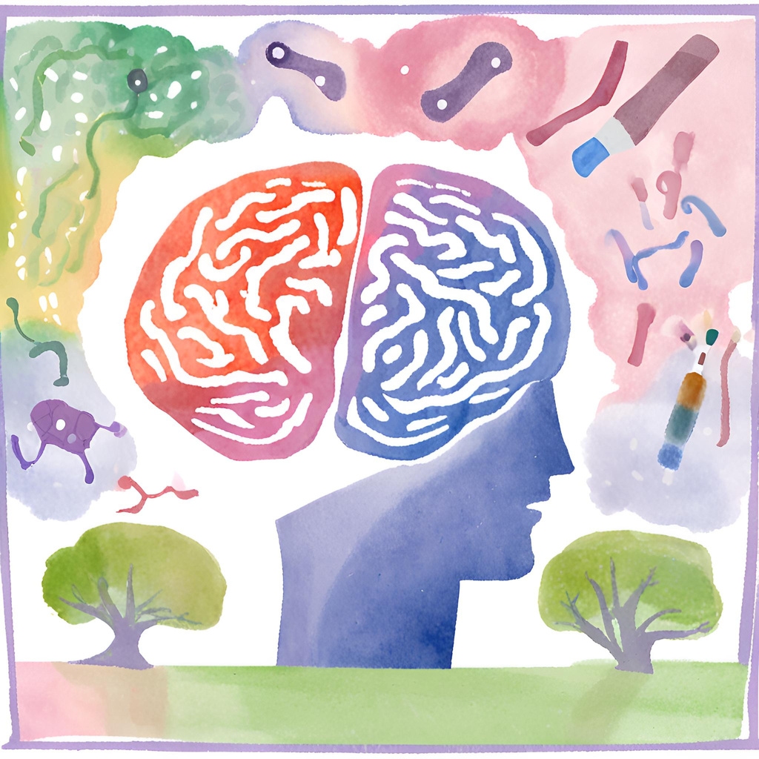



INTRODUCTION
How the brain processes visual information and why visual media is highly effective in enhancing memory and understanding?

Slide 3

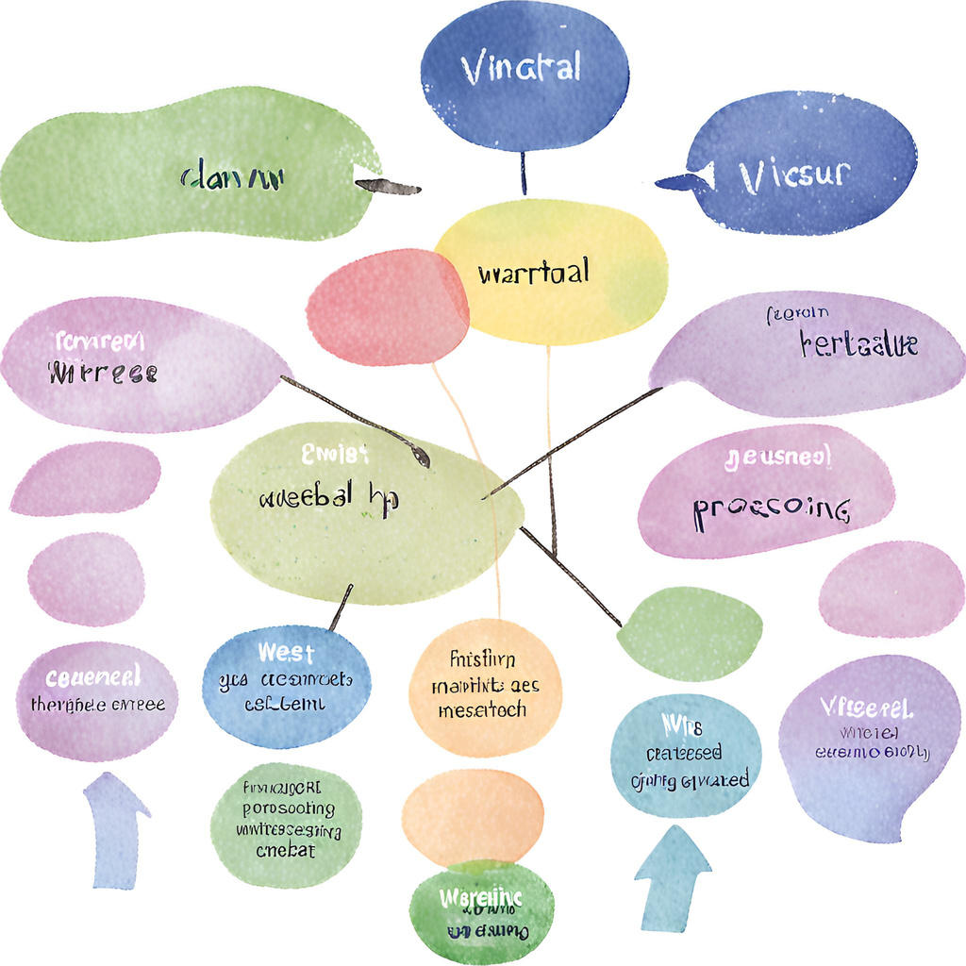


Dual Coding Theory
Developed by Allan Paivio in the 1970s, dual coding theory suggests that the brain processes information in two distinct modes:
Verbal Mode: Deals with words and language
Visual Mode: Deals with images and spatial representations

Slide 4

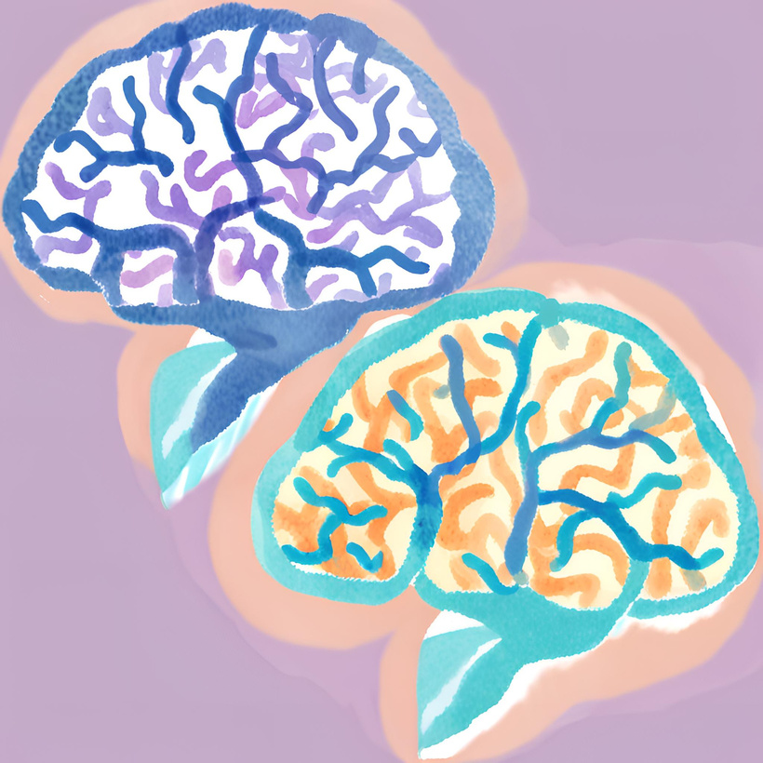




Dual Encoding Process
When people see an image, the brain processes it in both visual and verbal modalities, creating a dual representation of the same information. This increases the likelihood of long-term storage and easy recall, as information can be retrieved from both visual and verbal memory.

Slide 5



Picture Superiority Effect
Comparison of image and text recall
The picture superiority effect is a well-documented phenomenon in psychology demonstrating that people tend to remember pictures better than words. Images are more easily recognizable and recallable, especially when they are colorful, detailed, and concrete.

Slide 6






Why Images Are More Effective?
Emotional connection with images
Images are more easily processed and integrated into long-term memory.
They can be more easily associated with personal emotions and memories, further strengthening the memorization and learning process.

Slide 7



Practical Applications
how these concepts can be applied to create key messages?
Overcoming Stereotypes and Prejudices
Addressing Environmental Awareness Issues
Visual media can overcome stereotypes and prejudices by showcasing diverse and inclusive representations. Powerful images and infographics highlight the contributions of different groups, fostering empathy and understanding. Visual storytelling breaks down harmful stereotypes, promoting a more inclusive society and debunking myths with clear, factual representations.
Visual media effectively addresses environmental issues by illustrating the impact of human activities and promoting sustainable practices. Compelling images and videos raise awareness about climate change and conservation efforts, motivating action. Visual communication makes data accessible and engaging, inspiring positive change and collective efforts to protect the environment.

Slide 8







Conclusion
Understanding the link between visual media and cognition helps us leverage the power of images to enhance learning and communication. By using dual coding theory and the picture superiority effect, we can create impactful and memorable messages.

Slide 9
Thank you very much

