Slide 1


















Creating Visual Content in the Classroom
CHAPTER 3

Slide 2





INTRODUCTION
In this chapter, we will explore how to effectively use two tools discussed in the previous video: Canva and Snapseed.

Slide 3



Overview of Canva
A Versatile Design Tool
Canva is a free platform available on both desktop and mobile, allowing users to create graphics, videos, infographics, and social media content.
Key Features:
  Templates: Wide range of pre-designed templates.
  Accessibility: Easy to use for both beginners and professionals.
  Collaboration: Allows group work on projects.

Slide 4

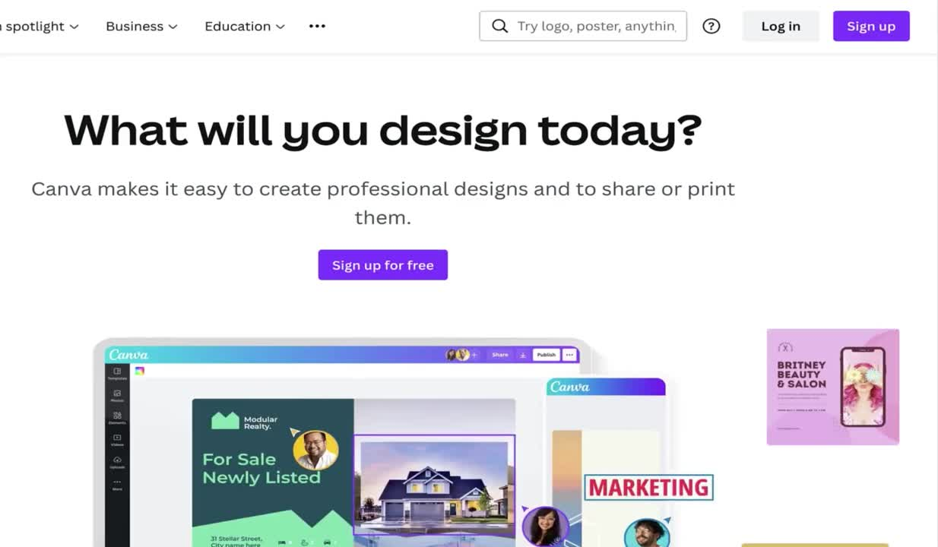
Getting Started with Canva
Step-by-Step:
  Sign up with email or social media.
2. Access the home screen with various project icons.
3. Choose the type of project (e.g., social media post).

Slide 5

Getting Started with Canva
Designing a Social Media Post
  Select "Social Media" and choose a platform (Instagram, Facebook, LinkedIn)
2. For example, choose Instagram and select the type of post (e.g., Instagram Post)
3. Click "Create Blank" to open the design dashboard
4. Use pre-made templates or import your own images.

Slide 6

Getting Started with Canva
Working with Templates
  Choose from free and premium templates.
2. Search for specific themes using keywords (e.g., "back to school")
3. Select a template, customize text and font, and adjust colors and elements
4. Change text font and color, add new elements, and animate graphics

Slide 7
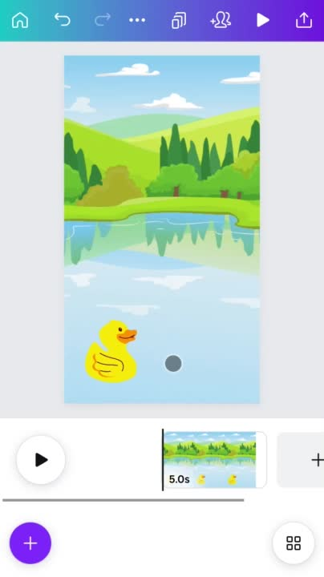
Getting Started with Canva
Animating and Adding Audio in Canva
  Use the "Animate" function to add movement to elements
2. Add music from the audio library to enhance your design
3. Create a carousel post by duplicating pages and adding animations and music
4. Exporting your design as an MP4 video or as JPEG/PNG for static images

Slide 8


Overview of SNAPSEED
A Powerful Photo Editor
Snapseed is a free, easy-to-use app for editing photos, available on Apple Store and Google Play
Key Features:
  Ease of Use: Intuitive interface for quick edits.
  Advanced Tools: Includes filters, effects, and detailed editing options.

Slide 9


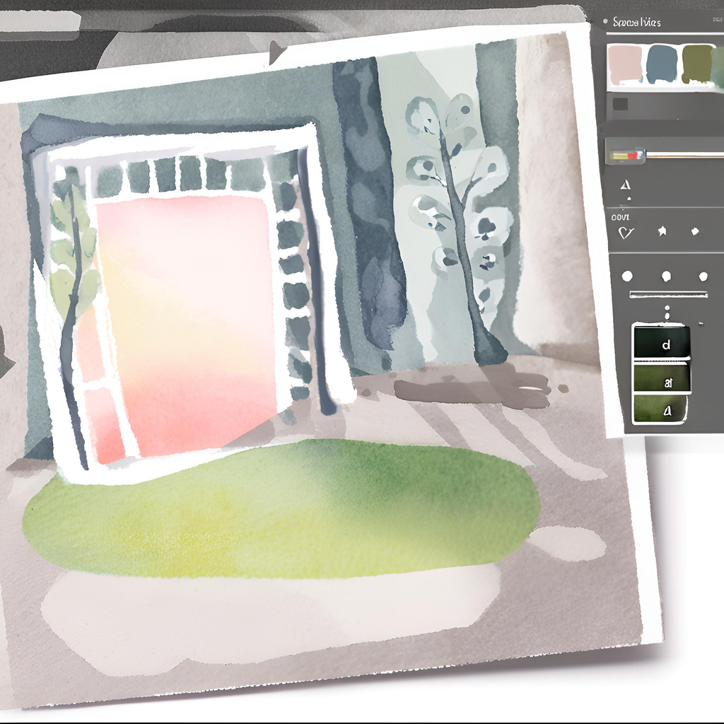



Getting Started with Snapseed
Editing Photos with Snapseed
  Open Snapseed and click "+" to choose a photo from your gallery
2. Access the editing dashboard with options for effects, tools, and export
3. Use tools for brightness, contrast, and cropping

Slide 10

Getting Started with Snapseed
Using Advanced Editing Tools
  Adjust details like sharpness and structure
2. Apply filters like "vintage" or "black & white"
3. Use the "magic wand" for automatic adjustments and save your edits
4. Add text and frames to your photos, and save/export the edited image

Slide 11



Giving and Receiving Feedback
  The Importance of Feedback
Feedback plays a crucial role in enhancing the quality of visual projects by providing valuable insights and perspectives that might not be apparent to the creator. When giving feedback, it is important to be specific, focusing on concrete aspects of the visual material rather than general comments. Objective and respectful feedback helps in addressing areas of improvement without causing defensiveness. Constructive criticism should highlight both strengths and weaknesses, offering actionable suggestions for enhancement. On the other hand, receiving feedback requires an open-minded attitude. It is essential to listen attentively, consider all opinions, and avoid becoming defensive. Embracing feedback positively and being receptive to suggestions can lead to significant improvements in the project. Asking clarifying questions ensures a better understanding of the feedback, allowing for more precise adjustments. Finally, expressing gratitude for the feedback demonstrates appreciation and fosters a collaborative environment, encouraging continuous learning and improvement.

Slide 12







Be specific and focus on concrete aspects.
Be objective and respectful
Giving and Receiving Feedback
  The Importance of Feedback
Avoid being defensive and be receptive to suggestions
Be open and listen attentively

Slide 13
Thank you very much

