Slide 1


















New Visual Communications in Media for Adult Education
CHAPTER 2

Slide 2






INTRODUCTION
In this chapter, we will explore the importance and effectiveness of visual communication in adult education.

Slide 3



WHY Visual Communication is Crucial?
Visual communication is crucial in adult education because it enhances engagement, understanding, and retention of information. Adults process visual information faster and more effectively than text, making images, infographics, and videos powerful tools for learning. By using visual aids, educators can simplify complex concepts, making them easier to grasp and remember. This approach not only caters to different learning styles but also makes the educational experience more dynamic and enjoyable, leading to better outcomes and higher motivation among adult learners.

Slide 4










WHY Visual Communication is Crucial?
90% of information processed by the brain is visual
We process images 60,000 times faster than text
80% of people remember what they see, compared to 10% of what they hear and 20% of what they read
The brain processes images in 13 milliseconds
93% of all human communication is visual

Slide 5






Overview of Free Tools
  Canva: Creating presentations, graphics, and videos.
  Snapseed: Simple and intuitive photo editing.
  CapCut: Advanced video editing with AI.
  Google Drive and Mirò: Collaboration and content sharing.

Slide 6



Canva
Presentation and Graphic Design Platform
Canva is a user-friendly platform that allows individuals and teams to create professional presentations, graphics, and videos. It offers a wide range of templates and design tools, making it easy to produce visually appealing content without needing advanced design skills. Canva is accessible on both mobile and desktop, enhancing its versatility and convenience for various creative projects.
https://www.canva.com/

Slide 7




Snapseed
Photo Editing App
Snapseed is a free and intuitive photo editing app developed by Google. It offers a wide range of tools and filters that allow users to enhance their photos with professional-quality edits. Available on both Apple Store and Google Play, Snapseed provides an accessible and powerful solution for photo editing on mobile devices.
https://play.google.com/store/search?q=snapseed&c=apps&hl=it&gl=US
https://play.google.com/store/search?q=snapseed&c=apps&hl=it&gl=US

Slide 8
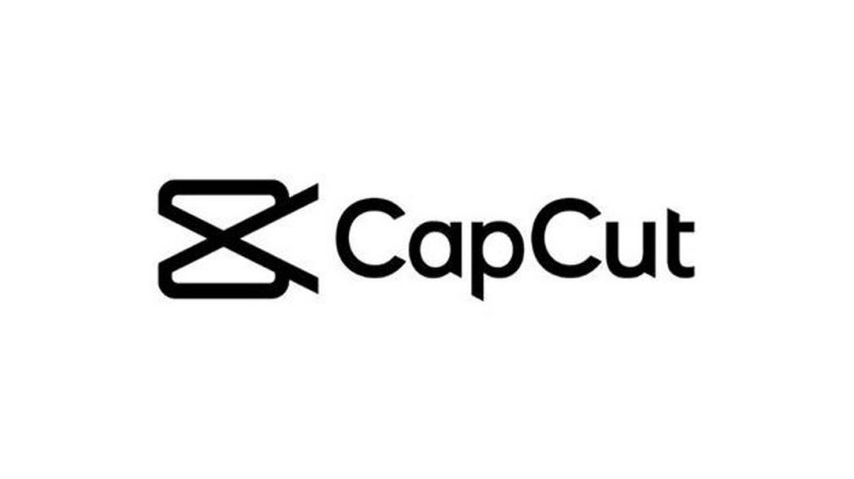
CapCut
Video Editing App
CapCut is a free, advanced video editing app widely used by TikTok users. It offers a variety of features, including video trimming, adding music, inserting subtitles, and applying effects, all enhanced by integrated AI. Available on both Android and Apple platforms, CapCut enables users to create high-quality videos and animations with ease.
https://play.google.com/store/apps/details?id=com.lemon.lvoverseas&hl=it&gl=US
https://apps.apple.com/it/app/capcut-editor-video-e-foto/id1500855883

Slide 9




google drive
collaboration platform
Google Drive is a cloud-based storage and collaboration platform that allows users to store, share, and collaboratively edit documents, presentations, and spreadsheets in real-time. It enhances productivity by enabling seamless access to files from any device and supports team collaboration through shared folders and real-time commenting.
https://drive.google.com/drive/home

Slide 10





MIRò
collaboration platform
Mirò is an online whiteboard platform designed for collaboration and brainstorming. It allows teams to create, share, and collaborate on conceptual maps, diagrams, and project plans. With its intuitive interface and versatile tools, Mirò enhances visual collaboration, making it easier to organize ideas and work together creatively in real-time.
https://miro.com/

Slide 11


Visual communication is a powerful tool in adult education, significantly improving engagement, understanding, and retention of information.
01.
By incorporating tools like Canva, Snapseed, CapCut, Google Drive, and Mirò, educators can create dynamic and interactive learning experiences. These visual aids simplify complex concepts, cater to various learning styles, and make the educational process more effective and enjoyable.
CONCLUSION
02.
Utilizing visual communication strategies enhances the overall impact of adult education, leading to better learning outcomes and higher motivation among learners.
03.

Slide 12
Thank you very much

