Slide 1


















Impact of Visual Communication on the Specificities of Adult Learning
CHAPTER 1

Slide 2








INTRODUCTION
Visual communication is fundamental for making adult learning more engaging and effective.
By using graphic elements, it is possible to improve the understanding and retention of information, facilitating a more dynamic and interactive learning experience.

Slide 3



Visual Communication
DEFINITION
Visual communication is the transmission of a message that can include ideas, instructions, data, or other types of information through graphic elements instead of text or sound.

Slide 4






Importance of Visual Communication
  Delivers the message with greater impact than simple text.
  Captures attention and increases engagement.
  Evokes stronger emotions in your target audience.
  Enhances information retention.
  Saves time as information is conveyed more quickly and effectively.

Slide 5



Methods of Visual Communication
Common Methods:
Videos and photos:
Videos and photos are powerful tools in visual communication that can significantly enhance the learning experience. Videos provide a dynamic way to illustrate processes, narrate stories, and demonstrate practical techniques that might be challenging to convey through text alone. They can engage learners by showing real-world applications and examples, making abstract concepts more concrete. Photos, on the other hand, can capture moments, highlight important information, and provide visual cues that aid memory retention. Both mediums help to create a more engaging and interactive learning environment, catering to various learning styles and improving overall comprehension.

Slide 6

Methods of Visual Communication
Common Methods:
Charts, diagrams, infographics, and other visual representations of typographic data:
Essential tools in visual communication that simplify complex information and data sets. Charts and diagrams help break down numerical data into understandable visual formats, making trends and patterns easier to identify. Infographics combine text, images, and design to summarize and present information in a visually appealing and easily digestible manner. These tools enhance comprehension by illustrating relationships, comparisons, and hierarchies among data points, which can be particularly useful in educational settings for summarizing research findings, explaining processes, and conveying statistics.

Slide 7
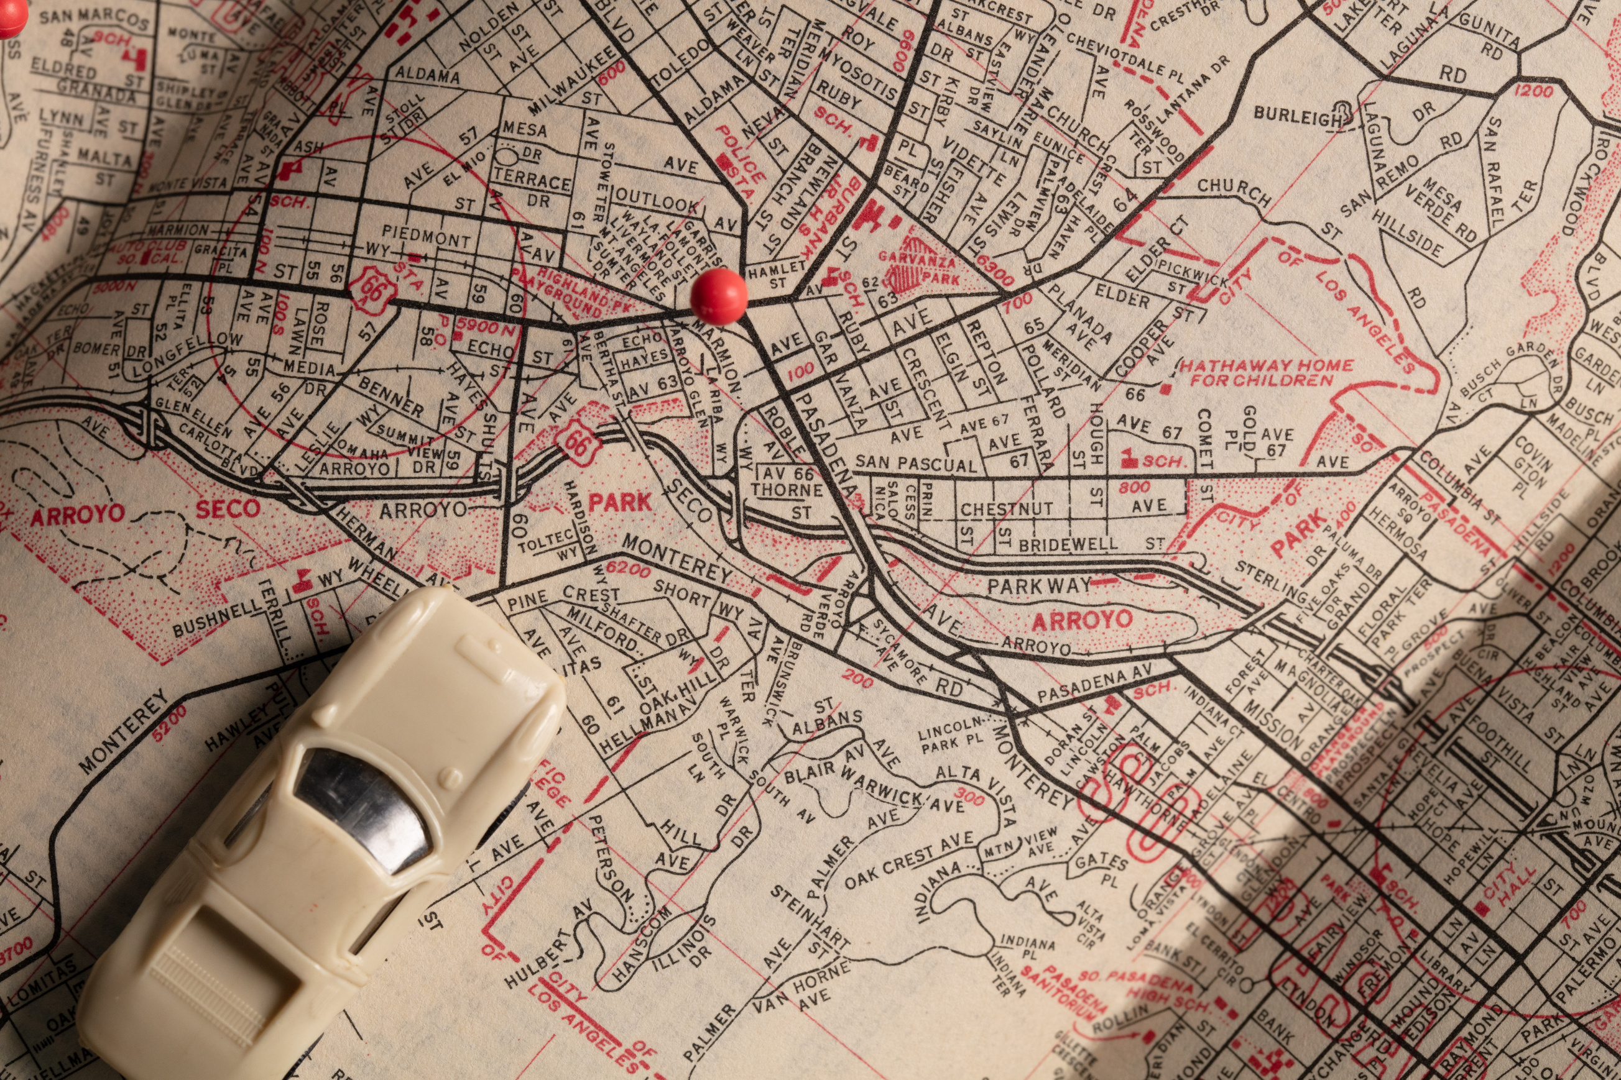
Methods of Visual Communication
Common Methods:
  Maps (such as conceptual and content maps)
Maps, including conceptual and content maps, are valuable tools in visual communication for organizing and presenting information. Conceptual maps help to visually represent the relationships between different ideas, making complex topics easier to understand by showing how various concepts are connected. These maps often include nodes and connecting lines that illustrate the hierarchy and relationships between ideas. Content maps, on the other hand, provide a structured way to outline specific content, such as project plans, curriculum topics, or processes. They help learners see the big picture and understand how different pieces of information fit together.

Slide 8

Methods of Visual Communication
Common Methods:
  Illustrations and graphic design
Illustrations and graphic design are key elements in visual communication that enhance understanding and engagement. Illustrations can simplify complex ideas and make abstract concepts tangible, while graphic design combines visual elements to create appealing and effective communication materials. Together, they make content more accessible and visually stimulating, improving the overall learning experience.

Slide 9
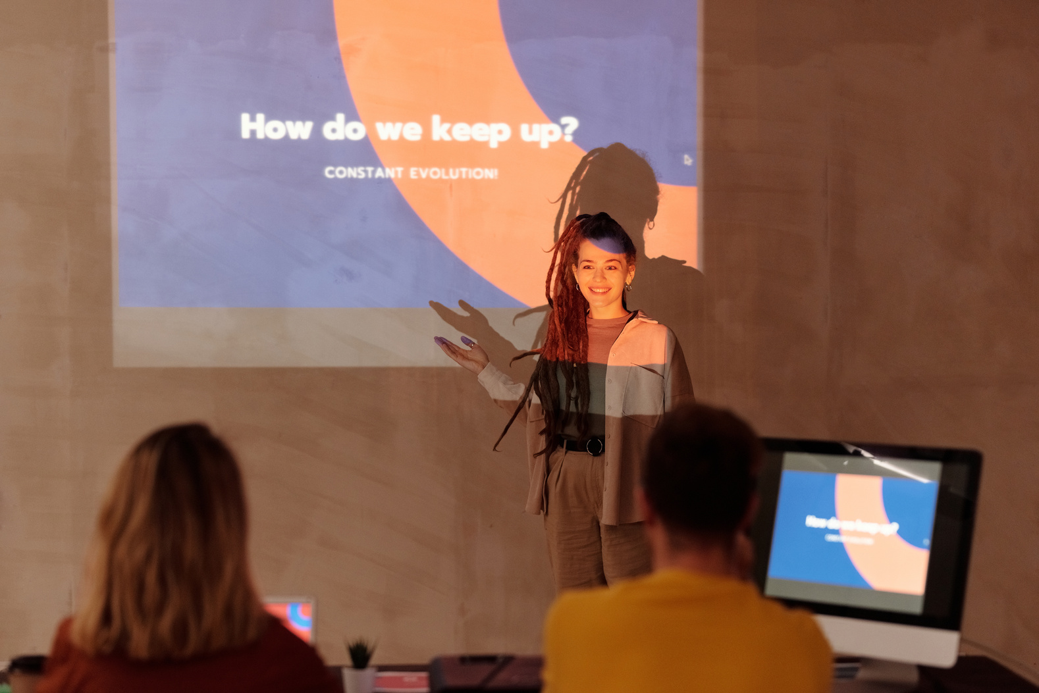
Methods of Visual Communication
Common Methods:
  Slides and presentations
Slides and presentations are effective tools in visual communication for delivering structured, dynamic content. They combine text, images, charts, and multimedia to create engaging and interactive lessons. By organizing information into digestible segments, slides and presentations help maintain audience attention and enhance understanding, making them ideal for educational and professional settings.

Slide 10

Methods of Visual Communication
Common Methods:
  GIFs
GIFs are short, looping animations that are highly effective in visual communication. They can quickly convey complex ideas or demonstrate processes in a visually engaging way. Due to their repetitive nature, GIFs can help reinforce key concepts and capture attention, making them a useful tool for tutorials, explanations, and enhancing the overall learning experience.

Slide 11


Implementation Strategies
Infographics can be used in adult learning to present effective study techniques visually. This could include tips on time management, active reading strategies, and the use of mind maps for better retention. By breaking down these techniques into visual elements, learners can easily grasp and apply them, enhancing their study habits and learning efficiency.
01.
Digital literacy is essential for adult learners in today's technology-driven world. An infographic can highlight key digital skills, such as navigating the internet, using email, and understanding online privacy. By visually representing these skills, learners can quickly identify areas they need to focus on and track their progress.
Infographics
02.
Infographics are excellent tools for synthesizing data and complex concepts into visually appealing and easy-to-understand formats. They can be used to introduce new topics or to summarize key lessons.
Infographics can outline various career development paths available to adult learners. This includes steps for advancing in their current career, transitioning to a new field, or acquiring additional qualifications. By visually mapping out these pathways, learners can better understand the steps they need to take to achieve their career goals.
03.

Slide 12


Implementation Strategies
Educational videos are highly effective for illustrating complex processes in a clear and understandable way. By visually demonstrating each step, learners can see exactly how a process unfolds, which is often more effective than reading about it. For example, a video can show the stages of scientific experiments, the procedure for solving mathematical problems, or the workflow of a particular software. This visual approach helps learners grasp intricate details and enhances their ability to replicate the process on their own.
01.
Educational Videos
Telling stories through educational videos can deeply engage learners and make the material more relatable and memorable. Stories can be used to present case studies, historical events, or real-life applications of theoretical concepts. By weaving information into a narrative, educational videos can evoke emotional responses and create a connection with the content. This method not only aids in retention but also helps learners understand the relevance and context of what they are studying.
02.
Videos can illustrate processes, tell stories, or demonstrate practical techniques that may be difficult to convey through text or oral lessons.
Educational videos excel in demonstrating practical techniques that learners can observe and then practice themselves. Whether it's a cooking tutorial, a fitness routine, or a technical skill like using a piece of machinery, videos provide a visual guide that can be paused, rewatched, and followed at the learner's own pace. This hands-on approach is particularly beneficial in vocational training and other fields where practical skills are essential. By watching experts perform these techniques, learners gain confidence and proficiency in applying what they have learned.
03.

Slide 13

Implementation Strategies
Multimedia presentations that combine text, images, and audio or video elements significantly enhance learner engagement. By integrating various media types, these presentations cater to different learning styles, making the content more accessible and interesting. For instance, a presentation on environmental science might include text explanations, images of ecosystems, audio clips of animal sounds, and videos showing environmental changes. This multimedia approach captures learners' attention, maintains their interest, and helps them better understand and retain the material.
01.
Multimedia Presentations
Using multimedia in presentations helps improve comprehension by providing multiple representations of information. Text alone can sometimes be abstract or difficult to understand, but when combined with images and videos, it becomes more concrete and relatable. For example, a lesson on the human circulatory system could include textual descriptions of blood flow, diagrams showing the heart and blood vessels, and a video animation demonstrating how blood circulates through the body. These combined elements reinforce the material, making it easier for learners to grasp complex concepts.
02.
Use presentations that combine text, images, and perhaps even audio or video, to create dynamic and interactive lessons. Use: Presentations to introduce new training modules. Example: PowerPoint with video clips and images to explain a scientific topic.
Multimedia presentations can facilitate interactive learning, encouraging active participation and collaboration among learners. Interactive elements, such as clickable links, embedded quizzes, and discussion prompts, can be included to make the learning experience more dynamic. For example, a history presentation might include video clips of historical events, followed by interactive maps and timelines that learners can explore. Additionally, audio narrations and video lectures can provide a more immersive learning experience, allowing learners to engage with the content in a more meaningful way.
03.

Slide 14

Implementation Strategies
Maps and mind maps are powerful tools for organizing information in a clear and structured way. They allow learners to visually see the relationships between different pieces of information, making it easier to understand and remember complex topics. For example, a mind map on the causes of World War II can illustrate how various political, economic, and social factors interconnect, providing a holistic view of the subject. This visual organization helps learners to see the big picture and understand how different elements relate to one another.
01.
Concept Maps and Mind Maps
Using maps and mind maps enhances memory retention by engaging both the visual and cognitive aspects of learning. The visual format of maps makes it easier for learners to recall information by associating concepts with specific visual cues. For example, a content map outlining a course syllabus can help students remember the structure of the course and the sequence of topics. By repeatedly reviewing the map, learners reinforce their memory, making it easier to recall information during exams or practical applications.
02.
Allow visualization of relationships and connections between different concepts. Powerful tools for organizing and structuring knowledge. Example: Using a concept map to plan a project.
Maps and mind maps facilitate creative thinking by encouraging learners to explore connections and generate new ideas. The open and flexible structure of mind maps allows learners to add branches and sub-branches, making it easy to brainstorm and organize thoughts. For instance, during a group project, students can use a mind map to collaboratively develop ideas, plan their approach, and outline the steps needed to achieve their goals. This creative process not only enhances problem-solving skills but also fosters collaboration and innovation.
03.

Slide 15
Implementation Strategies
Simulations and virtual reality (VR) offer immersive learning experiences that can significantly enhance the educational process. By creating realistic environments, learners can practice skills and apply knowledge in a safe and controlled setting. For example, medical students can use VR to simulate surgeries, allowing them to develop their skills without the risks associated with real-life procedures. This immersive approach helps learners gain hands-on experience and build confidence in their abilities.
01.
Simulations and Virtual Reality
Simulations and VR enhance understanding by allowing learners to apply theoretical knowledge in practical scenarios. This hands-on application helps bridge the gap between theory and practice. For instance, engineering students can use simulations to test the design and functionality of structures before physical prototypes are built. This not only reinforces their understanding of engineering principles but also enables them to identify and correct errors in a virtual environment, thereby improving their problem-solving skills.
02.
Offer immersive experiences that can significantly improve practical learning and student engagement. Use: Virtual lab simulations. Example: A virtual reality experience to learn surgical techniques.
The interactive and engaging nature of simulations and VR increases learner motivation and interest. These technologies make learning more dynamic and enjoyable by providing interactive challenges and immediate feedback. For example, language learners can use VR to immerse themselves in virtual environments where they can practice speaking with native speakers, enhancing their language skills in a realistic context. This level of engagement keeps learners motivated and encourages continuous learning, as they are more likely to stay committed to their educational goals.
03.

Slide 16






Conclusion
Visual communication is essential for improving adult learning. Using a variety of visual tools can increase engagement, understanding, and retention of information.

Slide 17
Thank you very much

