Slide 1


2. The Business Plan

Slide 2
2. The Business Plan
Who are you
What do you offer
Who are your customers
Who are the contestants
Accounts with reality

Slide 3
2. The Business Plan
Definition
The business plan can be conceived as the plan created ad hoc for a new initiative and responsible for assessing the attractiveness and financial feasibility of the project.

Slide 4
2. The Business Plan
Functionality
Internal: Evaluation of the potential of an investment project (for a start-up) or support for the current management of the business (for established companies). By measuring the financial and economic sustainability of the activity, guiding the implementation of the business operating plan and stimulating the contribution and adherence to the corporate mission of all those involved.

Slide 5
2. The Business Plan
External: Presentation of the project to external interlocutors to obtain the funds necessary to start operations.

Slide 6
2. The Business Plan
Editorial rules
Regardless of the quality of the project, a business plan, whether it is addressed to an "internal" (management guidance tool) or "external" (project business card) audience, must comply with a few simple drafting rules:

Slide 7
2. The Business Plan
a simple and essential but professional style
send attached documents that fully describe some aspects (generally technical), provided that their presence is considered essential
direct involvement of entrepreneur/manager
contain truthful, accurate and useful information

Slide 8
2. The Business Plan
Structure of the Business Plan
Executive summary
The project
Origin and history of the company
Motivations and opportunities
The business
The competitive environment (customers and competitors)
The operational plan
Production and logistics The marketing plan
The sales plan
The investment plan
Phases and deadliens
The financial plan

Slide 9
2. The Business Plan
ORIGINS AND HISTORY OF THE COMPANY
If the plan refers to a company already operating on the market, the reader must immediately be introduced to its history, providing elements such as the launch year, the ownership structure (over time), the legal form, the skills acquired, the typical activity, etc…
Also not forgetting to mention events of an extraordinary nature (disposals, management changes...) that have affected the company, and if and in what ways it belongs to an industrial group and/or financial.

Slide 10
2. The Business Plan
THE ACTIVITY
After having defined why and what you intend to achieve, you need to explain the business idea from, i.e. the activity you intend to carry on.
The descriptive characteristics of the productions must not be only "physical". In fact, it is necessary to describe the products through the analysis of the functions they perform in relation to the market and the need they go to satisfy.

Slide 11
2. The Business Plan
THE STRUCTURE
Both due to the importance of the topic in the planning process and due to the importance assigned to human resources by external interlocutors, the definition of the company structure and the organization of human resources is a fundamental part of the business plan.

Slide 12
2. The Business Plan
This part explains the choices in terms of:
legal form, taking care to clarify the shareholdings, any agreements signed by the shareholders (generally binding for a certain period of time), any fiscal, administrative and legal implications. All relevant aspects, with an often underestimated impact on current management;

Slide 13
2. The Business Plan
The partnerships, characteristics of the partners, role held, type of agreement and characteristics of the exchange underlying the partnership, temporal dynamics of the partnership;
external services, introducing the professionals
collaborators in the initiative (legal-tax assistance, insurance companies and banks);
Licences, patents, concessions and authorizations (if
relevant)

Slide 14
2. The Business Plan
THE ORGANIZATION
the management of the company, highlighting expertise and, if necessary, the steps still to be taken in preparation, and how the team has organized itself to achieve a high level of know-how;
the organizational chart, with the precise definition of management roles and responsibilities;
the motivation plan, i.e. how the corporate culture intends to act in order to approach the needs and expectations of its internal staff and collaborators (the issue of stock options).
The recruitment and training plan

Slide 15
2. The Business Plan
PRODUCTION AND LOGISTICS
Another theme is that of production, in which the objective of the analysis must focus on aspects such as:
the description of the transformation process adopted
the characteristics in terms of benefits but also of complexity (and possible risk) of the process
the foreseen quality control mechanisms
the machinery necessary to achieve the qualitative and quantitative objectives of the output

Slide 16
2. The Business Plan
Another topic that needs to be addressed is logistics, in an analysis that will have to focus on aspects such as:
handling, i.e. the means used for transport, the dedicated human resources, the management of information flows, the speed of delivery,…
the warehouse, including description and characteristics of the dedicated rooms and the stored goods, the
residual capacity in case of growth…
distribution, i.e. the choice of distribution channels to adopt.

Slide 17
2. The Business Plan
THE MARKETING PLAN
The task of whoever carries out this planning process is to demonstrate how he intends to translate the competitive strategies into a concrete sales plan. To obtain this result, it is necessary to define the marketing-mix levers, the product (service), the price, the promotion / advertising and the distribution / sales channels.

Slide 18
2. The Business Plan
Product/service
Beyond what has been enucleated about the offer previously, it is a question of investigating aspects such as the physical characteristics, packaging and accessories, for physical productions, and the qualitative aspects of assistance services.

Slide 19
2. The Business Plan
b) Price
A fundamental element in the marketing policy, to be correctly determined it must take into consideration the following aspects:
At the product level
elasticity/rigidity of demand
perception of the price component
At the company level
cost structure
sales plan and expected profit level

Slide 20
2. The Business Plan
c) Advertising/promotion
That is, the overall communication policy aimed at influencing customers' consumption attitudes in order to influence their sales. Among them, the plan must explain how the company intends to move in terms of:
Direct advertising - i.e. communication that has the company and its products as its theme, and which exploits the media (radio, TV, newspapers, magazines), direct channels (flyers, mail, telephone) or a hybrid form such as the Web.

Slide 21
2. The Business Plan
Indirect advertising - form of communication that addresses the object to be promoted as a reflection of an external event (the classic case is sponsorship).
Promotion – non-ordinary forms of sales incentives (one-off discounts, free samples, prize contests.

Slide 22
2. The Business Plan
d) Distribution/sales channels
No longer making the choice of distribution channel explicit, but illustrating how this choice is consistent with the target, the commercial policy and the pre-established economic objectives. Operation possible by addressing the following issues:
Cost/benefits - i.e. weighing the commercial benefits of a given choice against the relative costs;

Slide 23
2. The Business Plan
Product characteristics - suitability of the distribution solution with respect to product ownership;
Market characteristics - context situation and verification of availability/access to a channel;
Marketing-mix strategy - consistency of choice with respect to other marketing levers.

Slide 24
2. The Business Plan
THE INVESTMENT PLAN
For the start-up, tangible and intangible investments are required. All the investments planned in the five years of the project should be listed here business plan with an indication for each of:
cost
duration and economic amortization plan
payment methods (term and value of installments)

Slide 25
2. The Business Plan
THE SALES PLAN AND THE BREAKDOWN POINT
Defining the sales plan means planning the turnover objectives based on:
Company production capacity
Feasible selling prices
Size of the demand for the products offered.

Slide 26
2. The Business Plan
  Demand forecasting methods can be based on:
  market surveys. These are ad hoc studies on the market where forecasts and evolution scenarios may already be present.
  estimates and opinions of managers, employees and experts, in the event that there is the involvement of internal or external personnel able to make market estimates based on experience as well as on contacts and personal knowledge with customers / suppliers.

Slide 27
2. The Business Plan
Once the sales forecast has been determined, it may be appropriate to show, for the verification of the economic sustainability of the choices made, the operational break-even, i.e. the quantity that allows the balance between revenues and costs.
The formula provides for the breakdown of costs into fixed and variable as the quantity sold varies. Reaching the break-even point rarely occurs in the first year of a company's life, it is therefore advisable to make long-term forecasts in order to show in which year it is expected to reach it and what quantities will be needed to obtain it.

Slide 28
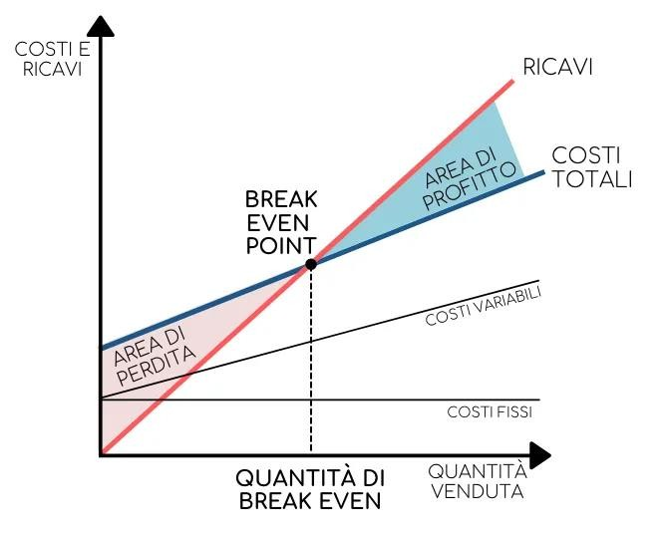
2. The Business Plan
COSTS AND INCOME
INCOME
TOTAL COSTS
PROFIT AREA
VARIABLE COSTS
LEAK AREA
FIXED COSTS
SOLD AMOUNT
AMOUNT OF BREAK EVENTS
ADADA

Slide 29
2. The Business Plan
DEVELOPMENT PHASES AND TIMES
This section of the business plan presents the activities to be developed in the start-up phase and the main milestones to be achieved in the first few years.
Through the clear definition of the planned operations to start and manage the business, detailing the times and resources involved through Gantt charts, it is possible to solve all the problems that can be foreseen already in the planning phase.
It also acts as an operational guide for those who will be about to carry out the work and gives an image of good organization to potential investors.

Slide 30
2. The Business Plan
THE FINANCIAL ECONOMIC PLAN
This section of the business plan is extremely important, it expresses the feasibility of the business idea in numbers, through an economic, financial and asset analysis of the project with the aim of underlining the attractiveness of the same for potential investors.
The tools to present this data are:
the forecast balance sheet;
the forecast income statement;
forecast cash flow;
for the first 5 years of the company's life.

Slide 31
2. The Business Plan
However, it is necessary to indicate:
list of annual management costs and the relative methods of payment of any contributions expected in the capital account or operating account from the EU or local government
the activation of credit lines
the amount of the share capital subscribed by the partners

