Slide 1


1. FROM THE IDEA TO THE STARTUP

Slide 2
1. From the idea to the startup
The frugal business
The secret of success
The niche of success
It wasn't there before

Slide 3
1. From the idea to the startup
The Frugal Business
A "frugal business" is one's own business that can be started without having large means, a possibility that did not exist twenty years ago

Slide 4
1. From the idea to the startup
The makings of the frugal:
Passion: money matters but motivation even more;
Independence: Spending long periods alone is not scary;
Adaptability and resistance to stress: you are ready to trade fixed income for the freedom of enterprise;
Resourcefulness: You are more likely to find a solution than complain about a problem

Slide 5
1. From the idea to the startup
Curiosity: one is attracted by novelty and contact with others;
Organization, method and order: in the family you are the one who keeps the family budget and organizes expenses;
Discipline: You are the boss and your subordinate too
Loving the work you choose to do

Slide 6
1. From the idea to the startup
Build a website and collect pre-orders
Put the product on eBay and wait for bids from buyers to determine the right price
Activate a business without investing in a supply by joining a dropshipping program
Measure the interest in the services you have in mind to offer by personally surveying some potential customers

Slide 7
1. From the idea to the startup
Dropshipping
When customers buy a product from a dropshipping merchant's store, the order is routed to the dropshipping supplier who stores, ships, and delivers the product on behalf of the merchant.

Slide 8
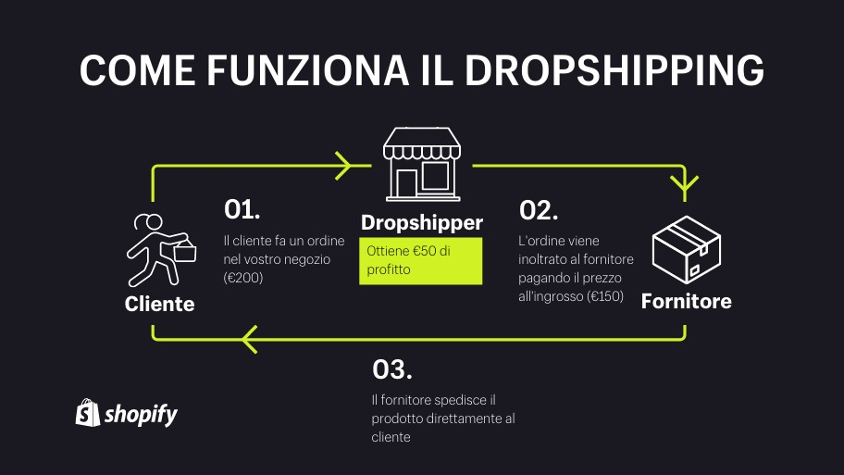
1. From the idea to the startup
HOW DROPSHIPPING WORKS
The customer places an order in your shop (200 €)
Gets €50 in profit
The order is forwarded to the supplier by paying the wholesale price (€150)
CLIENT
SUPPLIER
The supplier ships the product directly to the customer

Slide 9
1. From the idea to the startup
European Social Fund
The main channel for the development and financing of vocational training is the European Social Fund (ESF), which, together with other national channels, are used for structural interventions to consolidate employment, to help citizens find better jobs and ensure more equal job opportunities for all.

Slide 10
1. From the idea to the startup
For this reason, the financed training is aimed at workers, businesses, those who have difficulty relocating to the labor market, young people, and those in a socially disadvantaged condition.
The types of training interventions that are financed are identified on the basis of the purposes of the fund.
a) The promotion of the adaptability of workers and enterprises, thanks to the development, respectively, of new skills and new working methods.

Slide 11
1. From the idea to the startup
The development of lifelong learning systems, to ensure that all citizens obtain new skills and combat their obsolescence, recognizing future needs in professional terms and helping to develop life plans in this sense.
Support for people belonging to disadvantaged groups for job placement: the attention given to them is part of the objectives of promoting social inclusion by virtue of the role played by employment in promoting the integration of citizens into society and daily life.

Slide 12
1. From the idea to the startup
Idea di StartUp
Minus | Plus

Slide 13
1. From the idea to the startup
StartUp Idea
Minus | Plus
Few customers | Fast delivery times. Through proper communication you can earn yourself a place at the top of the list of people to call when a job is urgent
Absence of structure | Flexible solutions can be offered. Competitors are bureaucratic structures. Our customers need to know that they will have an answer anytime.
Few but good | We can't do everything but message that must come is that we do it well. Personalized relationship based on trust.
Small and unknown | Nice and informal communication style

